Slide 1

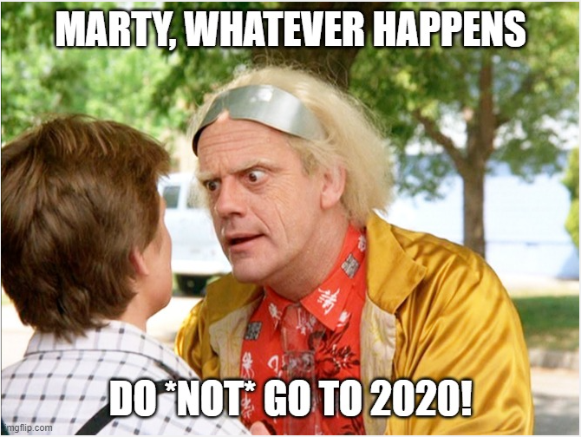

Burnout
more than just a bad day!
Seth Petry-Johnson

Slide 2
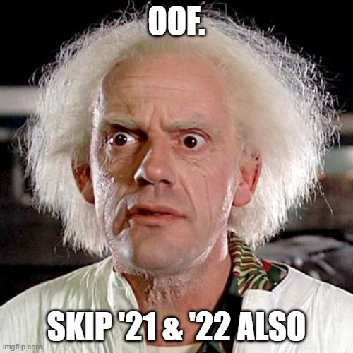
Burnout
more than just a bad day!
Seth Petry-Johnson

Slide 3
Burnout
more than just a bad day!
Seth Petry-Johnson

Slide 4

Burnout
more than just a bad day!
Seth Petry-Johnson
Employed Americans reporting worker burnout
76%

Slide 5
Burnout
more than just a bad day!
Seth Petry-Johnson
Employed Americans reporting complete burnout
9%

Slide 6
Burnout
more than just a bad day!
Seth Petry-Johnson
Employed Americans w/ no ideas for reducing burnout
1 in 10
Today’s agenda
Understanding burnout
Diagnosing and evaluating burnout
Treating / managing burnout

Slide 7
Burnout
more than just a bad day!
Seth Petry-Johnson
Employed Americans w/ no ideas for reducing burnout
1 in 10
Today’s agenda
Understanding burnout
Diagnosing and evaluating burnout
Treating / managing burnout

Slide 8
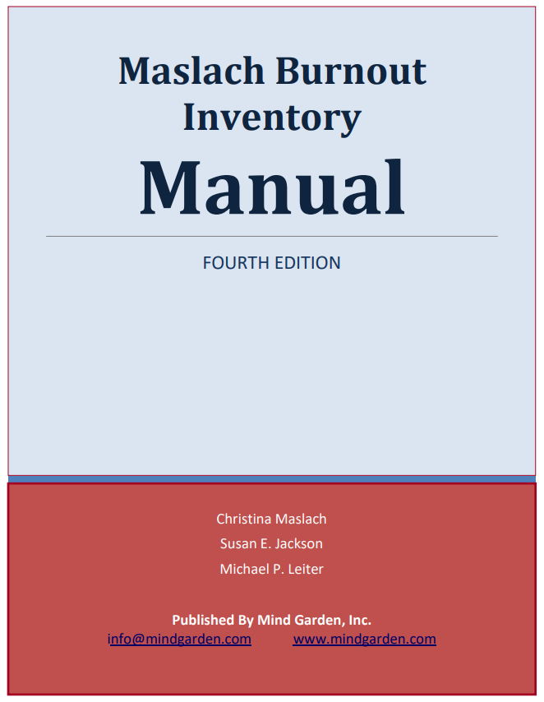
Burnout
more than just a bad day!
Seth Petry-Johnson
Understanding burnout

Slide 9
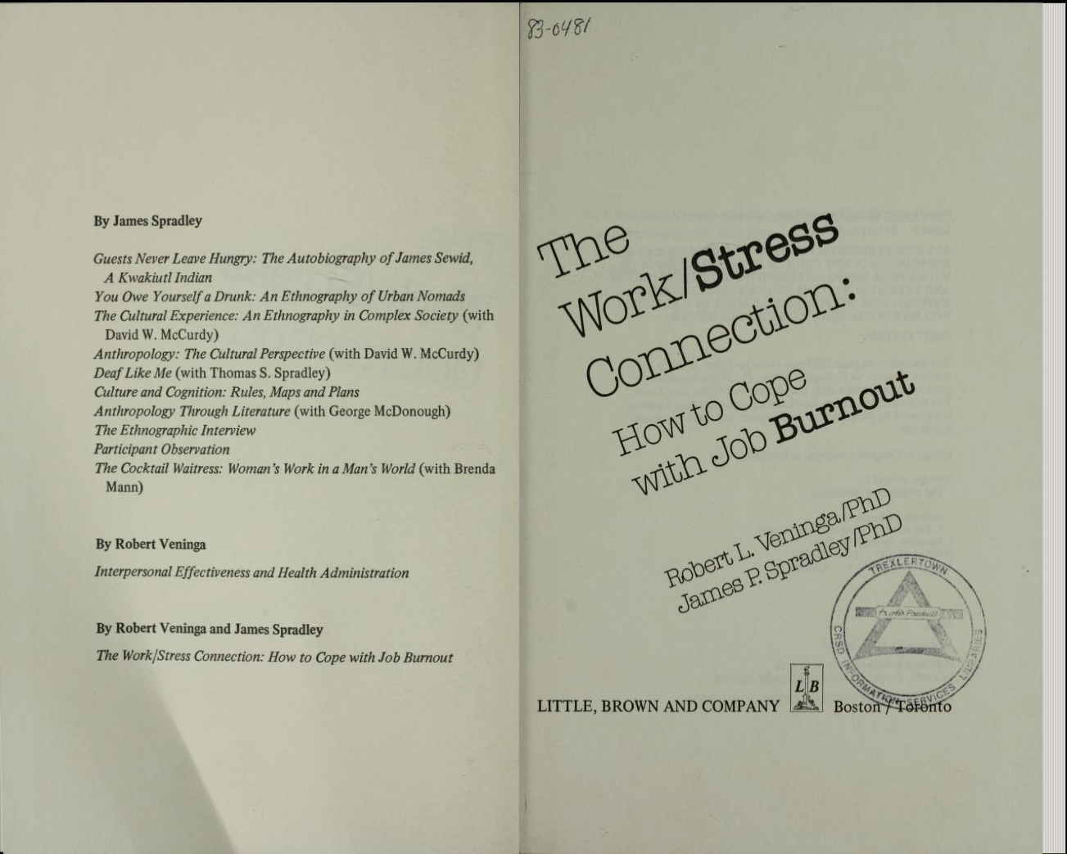
Burnout
more than just a bad day!
Seth Petry-Johnson
Understanding burnout

Slide 10
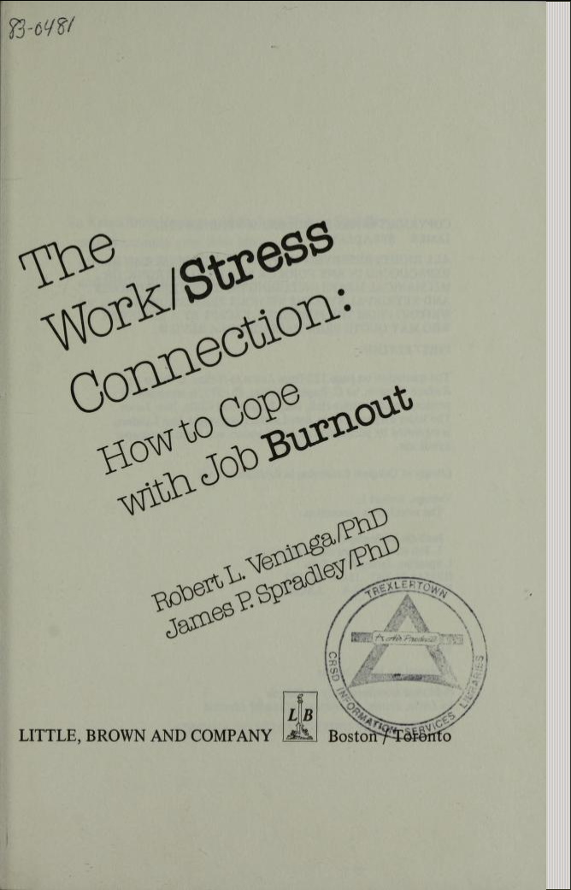
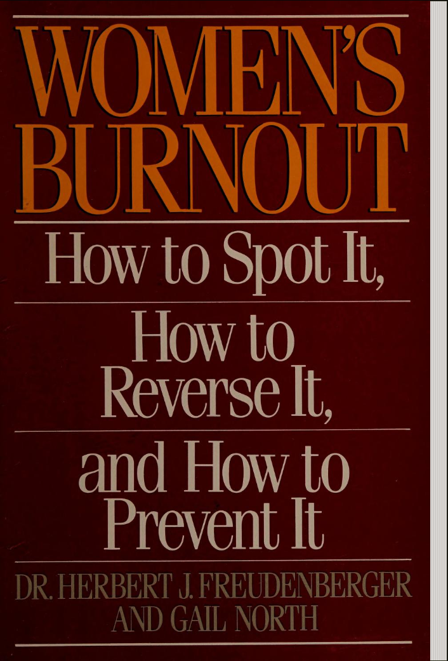
Burnout
more than just a bad day!
Seth Petry-Johnson
Understanding burnout

Slide 11
Burnout
more than just a bad day!
Seth Petry-Johnson
Understanding burnout

Slide 12
Burnout
more than just a bad day!
Seth Petry-Johnson
Understanding burnout
Burnout is a syndrome,
not a specific diagnosis

Slide 13
Burnout
more than just a bad day!
Seth Petry-Johnson
Understanding burnout
Burnout is a syndrome,
not a specific diagnosis
A syndrome is a group of symptoms that consistently occur together
Veninga and Spradley 5 stages
Burnout symptoms accompany chronic unmanaged stress
in the workplace

Slide 14


Burnout
more than just a bad day!
Seth Petry-Johnson
Veninga and Spradley 5 stages of workplace burnout
Honeymoon
High job satisfaction
Commitment / energy / creativity
Stress feels like “good stress”; we don’t recognize adaptation energy being used up

Slide 15

Burnout
more than just a bad day!
Seth Petry-Johnson
Veninga and Spradley 5 stages of workplace burnout
Fuel Shortage
Honeymoon
Begin to overdraw adaptation energy
Vague feeling of loss
“Balancing act”

Slide 16

Burnout
more than just a bad day!
Seth Petry-Johnson
Veninga and Spradley 5 stages of workplace burnout
Fuel Shortage
Chronic Symptoms
Honeymoon
Chronic exhaustion
Physical illness
Anger / depression

Slide 17

Burnout
more than just a bad day!
Seth Petry-Johnson
Symptoms become critical
Pessimism and self-doubt
“Escape mentality”
Veninga and Spradley 5 stages of workplace burnout
Fuel Shortage
Chronic Symptoms
Honeymoon
Crisis

Slide 18
Burnout
more than just a bad day!
Seth Petry-Johnson
Veninga and Spradley 5 stages of workplace burnout
Burnout transitions into significant and persistent physical or emotional problems
Fruedenberger’s 12 stages
Fuel Shortage
Chronic Symptoms
Hitting the Wall
Honeymoon
Crisis

Slide 19
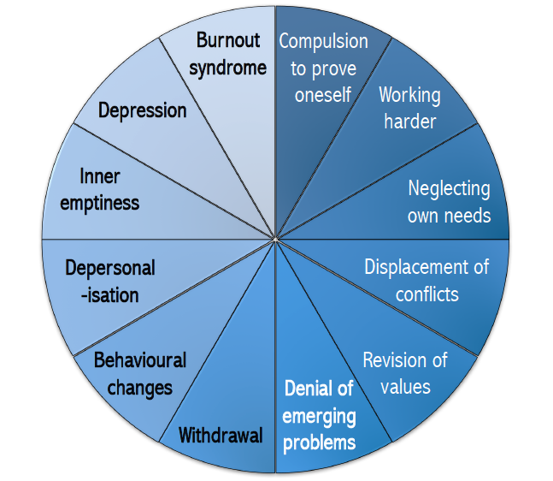
Burnout
more than just a bad day!
Seth Petry-Johnson
Veninga and Spradley 5 stages of workplace burnout
Fruedenberger’s 12 stages
Hitting the Wall
Honeymoon
→
Maslach Burnout Inventory 3 feelings of burnout

Slide 20
Burnout
more than just a bad day!
Seth Petry-Johnson
Veninga and Spradley 5 stages of workplace burnout
Maslach Burnout Inventory 3 feelings of burnout
Fruedenberger’s 12 stages
Hitting the Wall
Honeymoon
→
Emotional Exhaustion
Cynicism
Low Professional Efficacy

Slide 21
Burnout
more than just a bad day!
Seth Petry-Johnson
Maslach Burnout Inventory 3 feelings of burnout
Emotional Exhaustion
Cynicism
Low Professional Efficacy

Slide 22
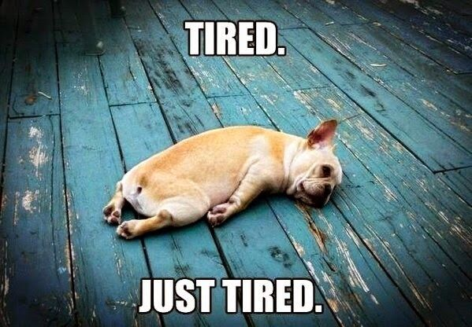
Burnout
more than just a bad day!
Seth Petry-Johnson
Understanding burnout
Burnout symptoms:
Depleted energy reserves
Pervasive feeling of exhaustion

Slide 23
Burnout
more than just a bad day!
Seth Petry-Johnson
Understanding burnout
Burnout symptoms:
Depleted energy reserves
Hard to get out of bed in the morning

Slide 24
Burnout
more than just a bad day!
Seth Petry-Johnson
Understanding burnout
Burnout symptoms:
Depleted energy reserves
Loss of interest in leisure activities

Slide 25
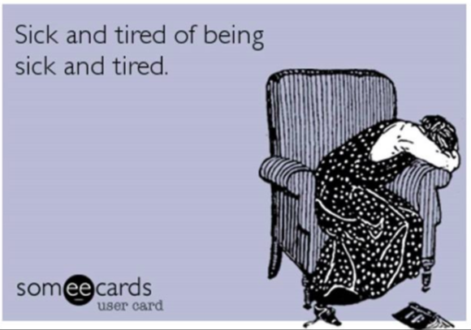
Burnout
more than just a bad day!
Seth Petry-Johnson
Understanding burnout
Burnout symptoms:
Depleted energy reserves
Withdrawal from relationships /
“No fun to be around”

Slide 26
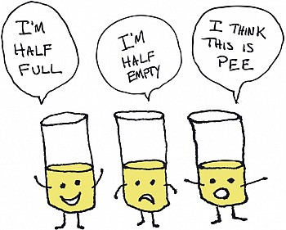
Burnout
more than just a bad day!
Seth Petry-Johnson
Understanding burnout
Burnout symptoms:
Depleted energy reserves
Lowered resistance to illness

Slide 27
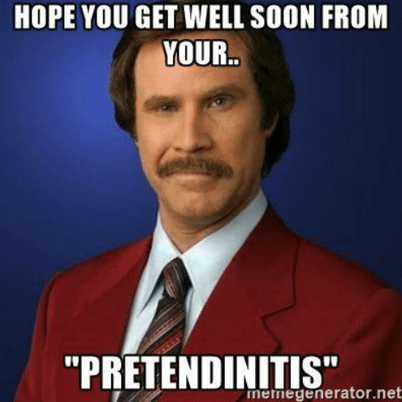
Burnout
more than just a bad day!
Seth Petry-Johnson
Understanding burnout
Burnout symptoms:
Depleted energy reserves
Lowered resistance to illness
Increased dissatisfaction and pessimism

Slide 28
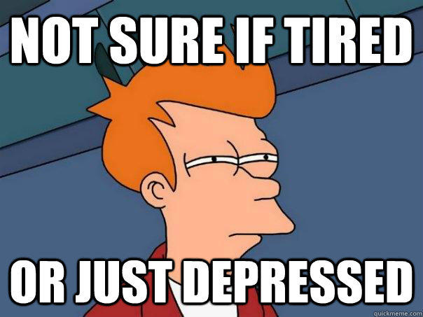
Burnout
more than just a bad day!
Seth Petry-Johnson
Understanding burnout
Burnout symptoms:
Depleted energy reserves
Lowered resistance to illness
Increased dissatisfaction and pessimism
Increased absenteeism and inefficiency at work

Slide 29
Burnout
more than just a bad day!
Seth Petry-Johnson
Understanding burnout
Burnout symptoms:
Depleted energy reserves
Lowered resistance to illness
Increased dissatisfaction and pessimism
Increased absenteeism and inefficiency at work

Slide 30
Burnout
more than just a bad day!
Seth Petry-Johnson
Understanding burnout
Burnout is a syndrome of three types of feelings:
Emotional exhaustion
Depersonalization
Low personal accomplishment

Slide 31

Burnout
more than just a bad day!
Burnout is a state of
emotional, physical, and mental exhaustion
caused by excessive and prolonged stress
Today’s agenda
Understanding burnout
Diagnosing and evaluating burnout
Treating / managing burnout

Slide 32
Burnout
more than just a bad day!
Burnout is a state of
emotional, physical, and mental exhaustion
caused by excessive and prolonged stress
Pandemic
Inflation
Politics
Job insecurity
Family stress
WFH / RTO
Adulting
Turnover

